Slide 1

Project Manager
Ali Alkhaiyat
STEM Display B Team 15
Secretary & Client Contact
David Rankin
Budget Liaison
Carlos Shields
Website Developer
Kevin Park
[1]
Notes:
Good evening
We are the wonder factory STEM display B Team 15
Ali Alkhaiyat: project manager
David Rankin: Secretary & client contact
Carlos Shields: Budget Liaison
Kevin Park:Website Developer

Slide 2
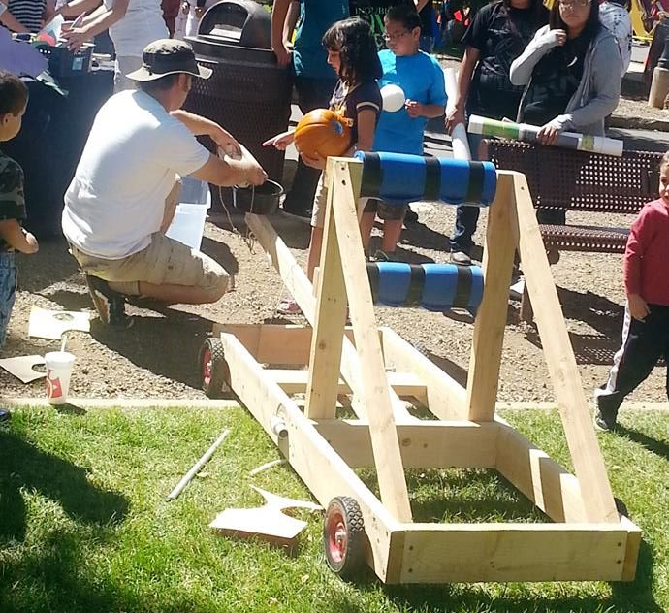
Project Description
The Wonder Factory
Interactive learning center
Goal
Generate learning through play
Location
Flagstaff, AZ
[1]
Ali Alkhaiyat 2/1/2017 The Wonder Factory STEM Display B - Team 15
Notes:
What is the Wonder Factory?
The Wonder Factory is the interactive science, technology, engineering, art and math (STEM/STEAM) in Flagstaff, AZ
The Wonder Factory was founded by two people who they are Jackee and Steve Alston
The Wonder Factory goal is to lead the next generation of young minds into their place as the thinkers, the makers, and the creators of the future through hands-on interactions with science, technology, engineering, art, and mathematics.

Slide 3
Project Description
- Must be safe to all users per applicable safety standards. Safety is our first priority!!
- Must be ready upon completion of this capstone sequence
- Must select, design, build, and test one final unique idea
- Should test the interactive display in a similar setting to expected everyday use
- Must interact with the clients in order to maintain parity with their expectations
Project Expectations
- No design changes
Ali Alkhaiyat 2/1/2017 The Wonder Factory STEM Display B - Team 15
Notes:
The major goals for our project are listed below:
must be safe to all users
must be ready
must select, design, build and test one final unique idea
use critical thinking to solve a problem
use formal methods of teaching and make more fun for children
Project Expectations
The design stays as it is and we did not change it.

Slide 4
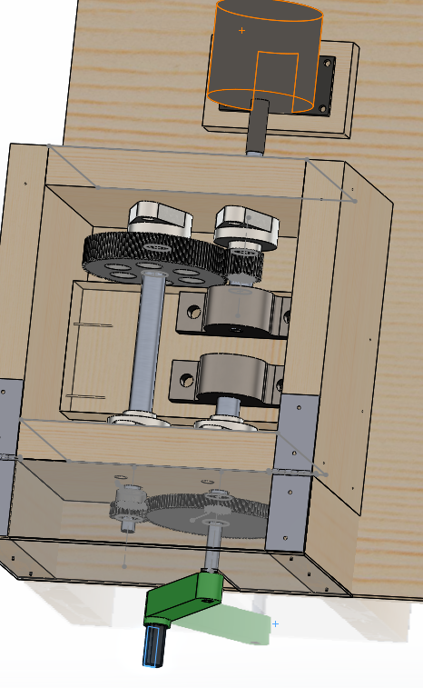
Updates
Top mounted bearing
Fixed interior gears
Inter-changeable gears
Wall mounted bearing
Generator
Crank arm
Cover
New design of model
Kevin Park 2/1/2017 The Wonder Factory STEM Display B - Team 15
Notes:
This image is the result that we have been updating. To play our project "race pit", they need to generate electricity as much as 20 to 22V. The generator we are currently using requires 1100 RPM theoretically. We assumed the operator will rotate the crank arm with 70RPM. Then we knew we need to 1:16 gear ratio. At the beginning of last semester, we designed only 2 gears to meet 1100 RPM. However, it was really hard to manufacture because ( ). Thus, we decided to build our gearbox like this and both front and rear gear ratio is 1:4. We are planning to help the kids to change inter changeable gears and to understand how gears are working. The big differences of design between final presentation and this one are gear shape and wood bricks supporting top mount bearing.

Slide 5
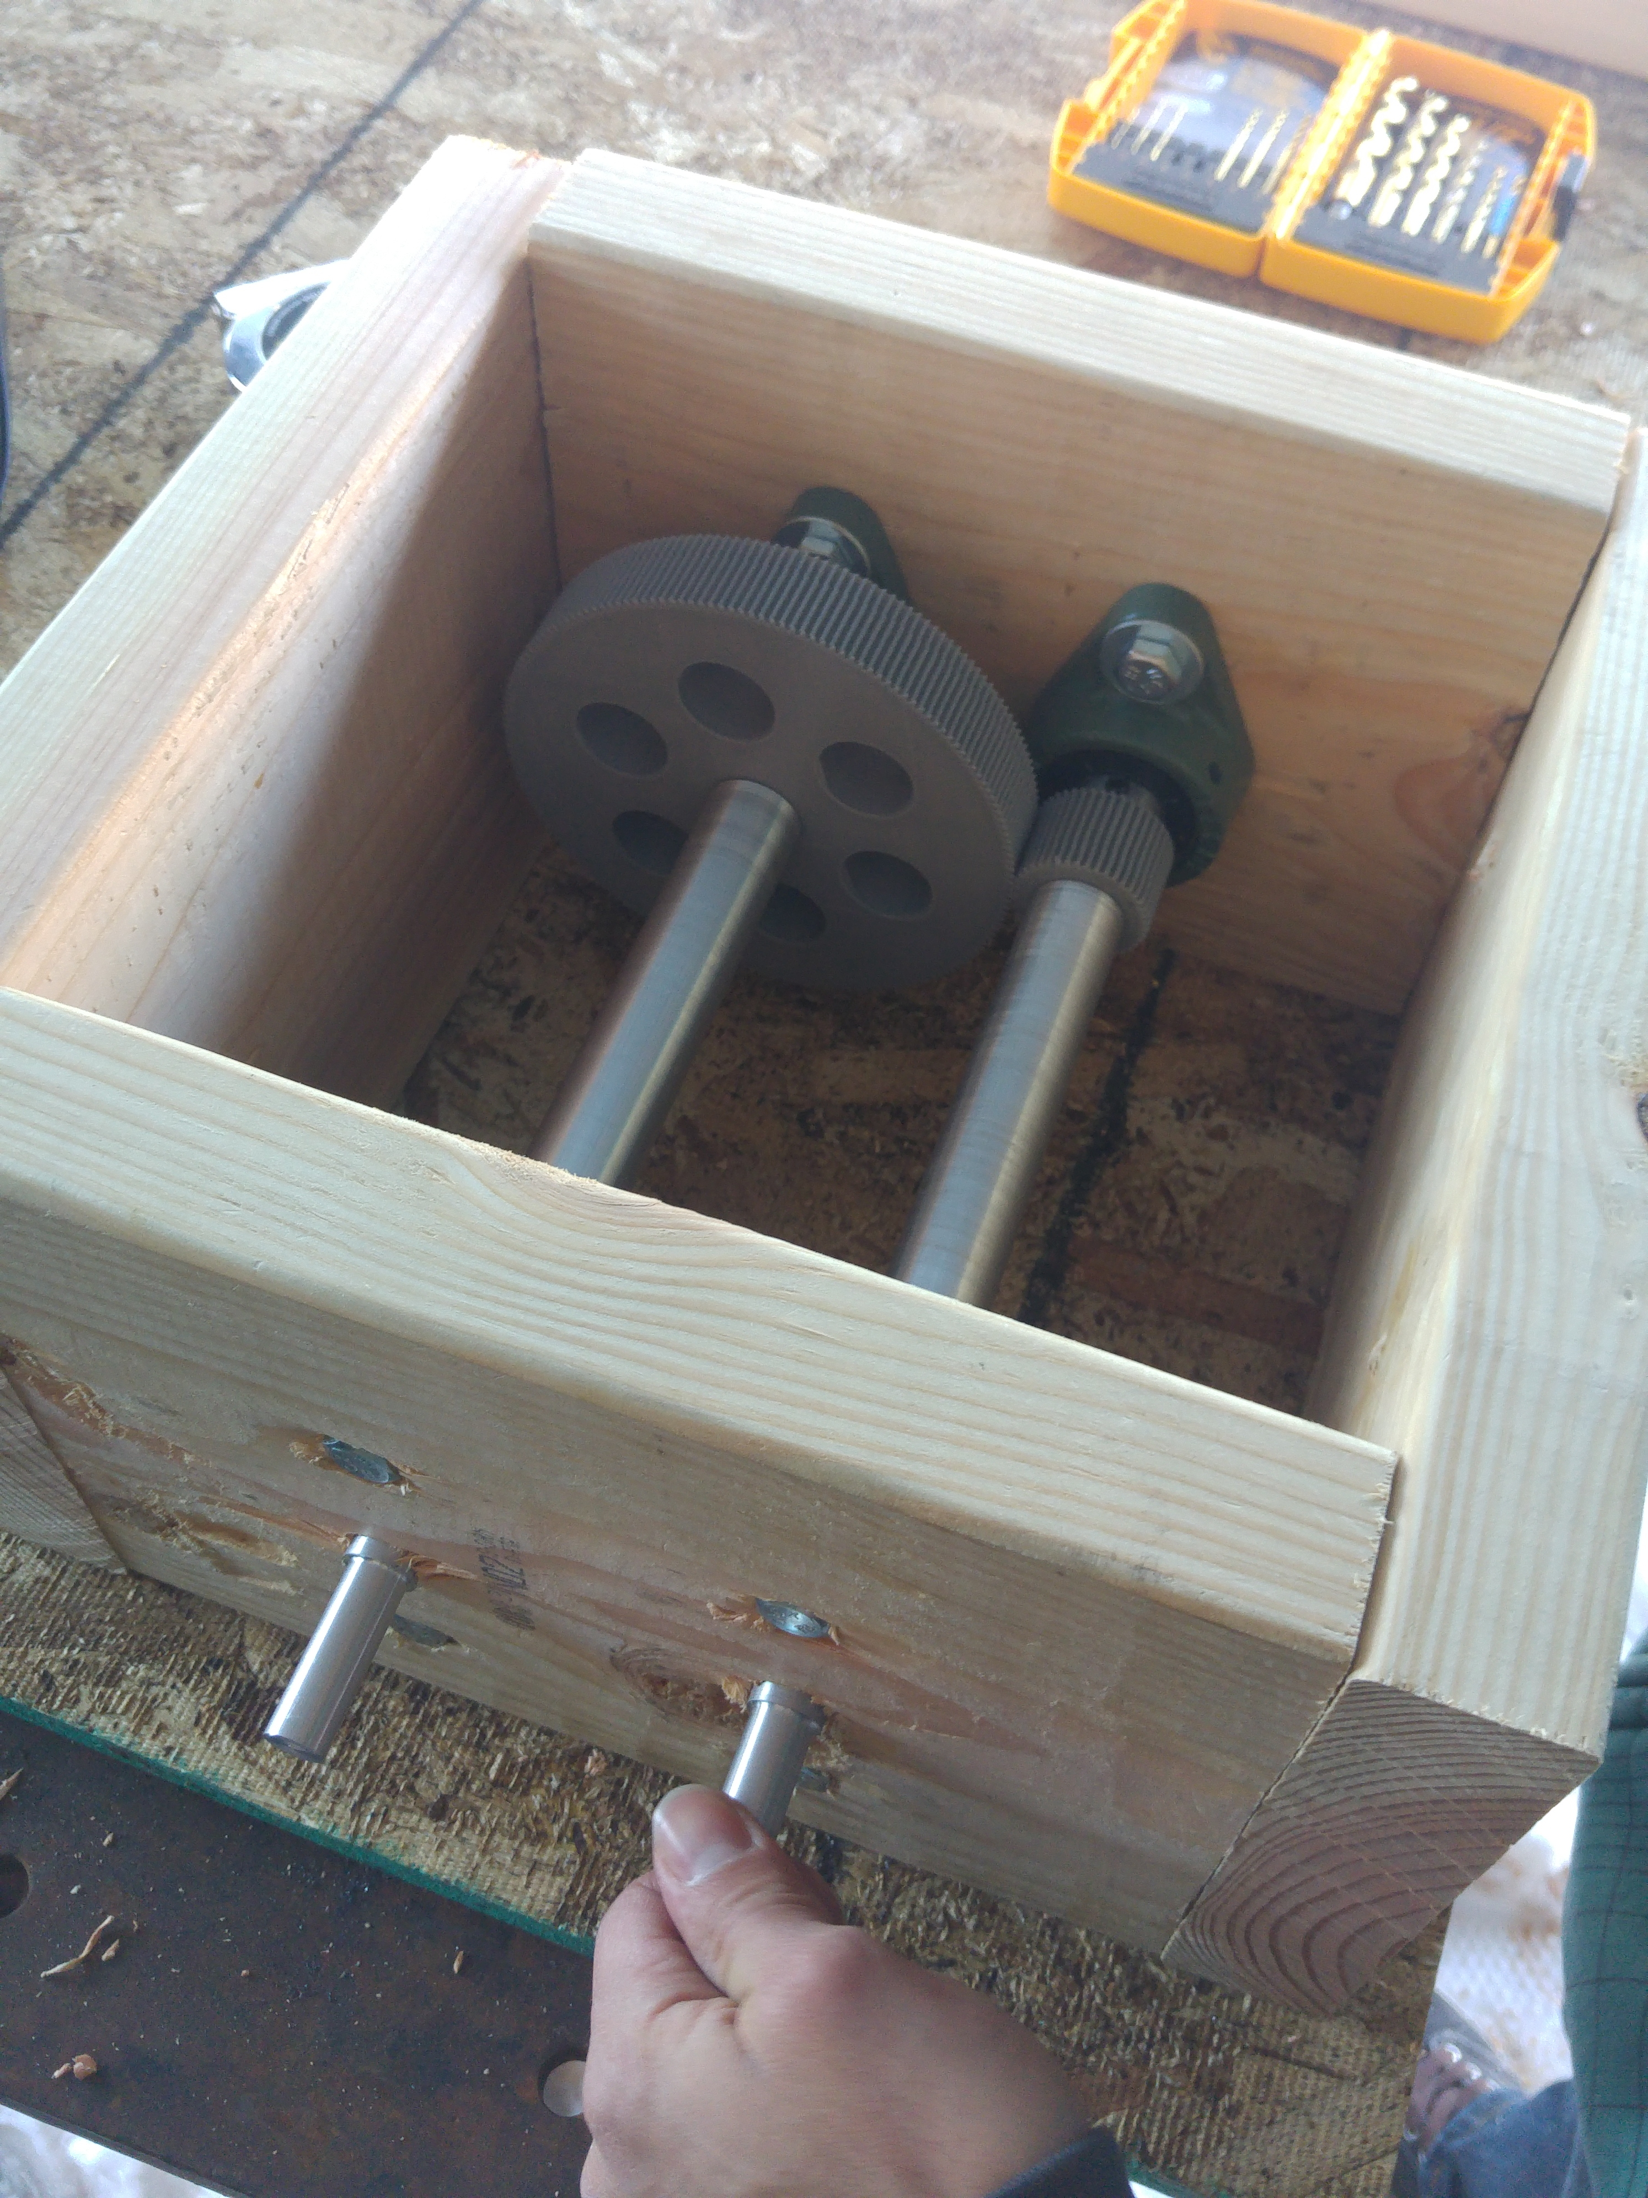
Updates
Budget decrease
Start to build gearbox last week
Use different Vendors
Use different and less expensive materials (Gear shape, 3D printing gears)
First manufactured model
(photo taken by Kevin Park)
Kevin Park 2/1/2017 The Wonder Factory STEM Display B - Team 15
Notes:
- researching different vendors to reduce budget
- using different, less expensive materials to reduce budget without compromising the structural integrity
-

Slide 6
Manufacturing Plan
Timeline
One station complete – Feb 13, 2017
Testing complete – Feb 20, 2017
Two stations complete and operation ready – March 5, 2017
We plan to attend and display our project at the Flagstaff Community STEM Celebration in the Skydome with The Wonder Factory on March 6, 2017
David Rankin 2/1/2017 The Wonder Factory STEM Display B - Team 15
Notes:
We have already begun the manufacturing process. Our team plans to have one station fully assembled by February 13th. Our team will then complete all of our testing by February.20th. We plan to test the power generator's output voltage and current at different input RPMs by using a mill to rotate it. After we check the generator, we will connect it to the racetrack to test the generator's ability to power one slotcar.As of now, we are planning to use 3D printed gears. We will test the rear gear, which will see the highest RPMs, first by connecting the shaft and gearbox to the mill. We will rotate the shaft at a rate we anticipate the gears will operate at for 5 minutes then check for gears wear. We plan to test the front gears to see if they will operate without a retaining ring or if the user will need to attach a clamp prior to operating the gearbox. Our final test will be to test various types of safety mechanisms that will not let the shafts rotate when the front cover is open and will allow the shafts to engage when the cover is closed and locked.
After all of the testing and finalizing our plan for the stations, we will construct a second station by March 5th. By this time, we plan to have two complete stations that are ready for full operation and display.We plan to attend and display our project at the Flagstaff Community STEM Celebration being held in the Skydome with The Wonder Factory on March 6th. At this event, we hope to gather information on how we can improve our project by asking the people that play with our project what they liked, what they didn't like, what confused them, and any suggestions they might have for us.

Slide 7
Manufacturing: Team Skills and Responsibilities
Ali
Gearbox construction assist
Gear testing lead
Full assembly assist
Safety and quality control lead
David
Gearbox construction lead - lathe and mill certified with carpentry background
Generator/racetrack testing and wiring assist
Full assembly lead
Safety and quality control assist
Carlos
Electronic circuit puzzle lead
Generator/racetrack testing and wiring lead
SolidWorks and website assist
Instruction/information poster assist
Kevin
Electronic circuit puzzle assist
Gear testing assist
SolidWorks and website lead
Instruction/information poster lead
David Rankin 2/1/2017 The Wonder Factory STEM Display B - Team 15
Notes:
Overall, our team is fully capable of completing our project without hiring help. Each team member has completed the machine shop safety training. I have completed the lathe and mill advanced training and I also have a background is carpentry. Each overall task has a primary and secondary person assigned to it which is indicated by lead and assist, respectively. Ali is the lead for the gear testing and for the safety and quality control. Carlos is the lead for the electronic circuit puzzle and for the generator and racetrack testing and wiring. I am the lead for the gearbox construction and for the full assembly of the design. Kevin is the lead for the SolidWorks file, website, and the instructional posters that explain how to operate the project and the information poster for UGRADS.

Slide 8
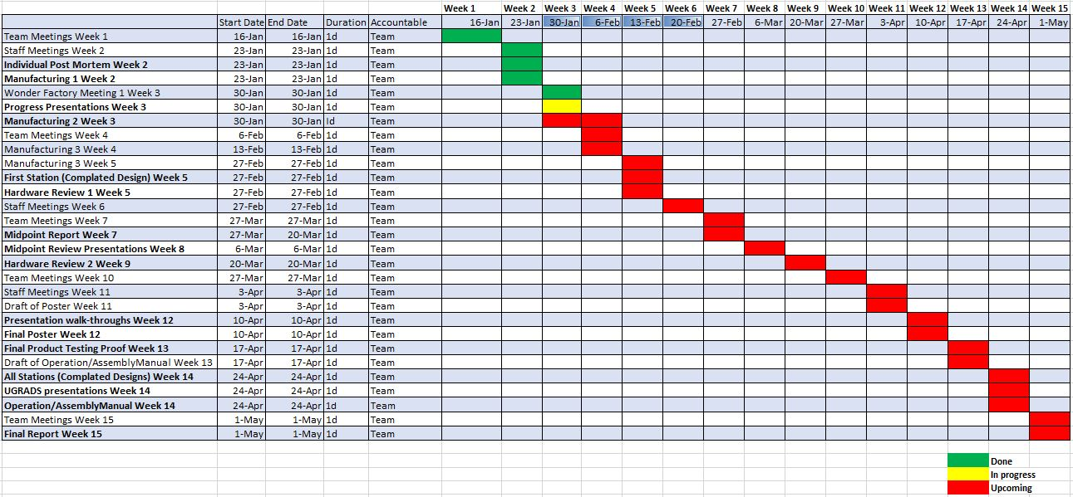
Schedule - Gantt Chart
Juan Carlos Shields 2/1/2017 The Wonder Factory STEM Display B - Team 15
Notes:
So far we are on schedule.We should be able to meet class requirements and dates easily.We are planning to go a little ahead of schedule and have 2 stations working by march 6th so we can make the Flagstaff community STEM celebration with our clients.

Slide 9

Budget
$2,000 (Grants Optional)
Spent so far: $983.25 for the track and building materials
Extra funding approved
Projected Spending $1893.89
Projected Balance: $106.11
Juan Carlos Shields 2/1/2017 The Wonder Factory STEM Display B - Team 15
Notes:
Gore funds many of the mechanical capstones and we are happy that they have decided to fund ours.
Before the break we applied for extra funds and had that approved. That increased our budget from $1500 to $2000
So far we have been buying the parts with our own money and then getting our money reimbursed by the school. This way we are able to get what we need whenever we want.

Slide 10
QUESTIONS?
THANK YOU!
2/1/2017 The Wonder Factory STEM Display B - Team 15

Slide 11
References
[1] The Wonder Factory [Online]. Available: www.facebook.com/thewonderfactoryflagstaff

